Slide 1
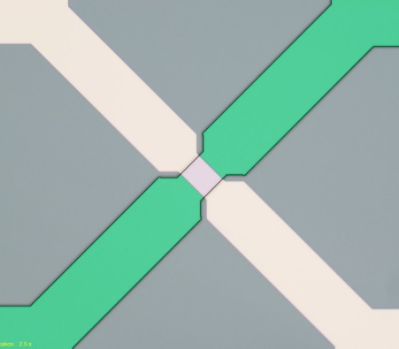
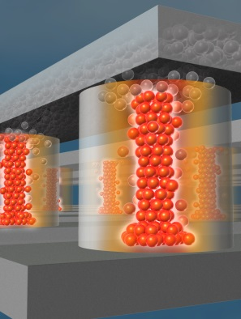
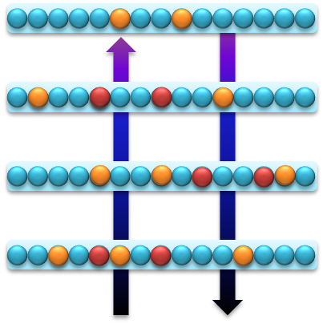


Neurologically Inspired Architectures and Algorithms for Stream Processing
John Naegle
Sandia National Laboratories
Chesapeake Large Scale Analytics Conference, October 25-27, 2016
1

Slide 2






Acknowledgments
Algorithms: Brad Aimone, Ojas Parekh, Nadine Miner, Sandra Faust, Steve Verzi, Fred Rothganger, Frances Chance, Tu-Thach Quach, Chris Lamb, Sam Mulder, William Severa, Kris Carlson, Michael Smith, Cynthia Phillips
Architecture: John Naegle, Alex Hsia, Craig Vineyard, John Donaldson, Aaron Hill
Hardware: Matt Marinella, Tom Beechem, Ron Goeke, Alec Talin, Paul Kotula, Farid El Gabaly, Elliot Fuller, Jim Stevens, Sapan Agarwal, David Hughart, Andy Armstrong, David Henry, Gaadi Haase, Steve Wolfley, Derek Wilke, Michael Van Heukelom, Michael Thomas, Anthony McDonald, Carl Smith
Modeling: Steve Plimpton, Richard Schiek, Brian Tierney, Robert Bondi, Fred Rothganger
Application areas: Tim Draelos, Justin Doak, Jonathan Cox, Joe Ingram, Jason Wheeler
Partnerships:
David Follett, Duncan Townsend – Lewis Rhodes Labs
Isaac Richter - U. Rochester; Felix Wang – UIUC; Marek Osinski – UNM;
Notes:
Flashed to show size of team

Slide 3

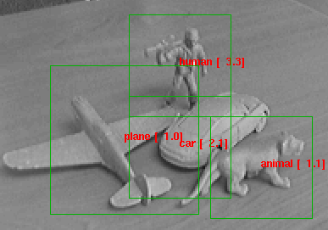
Neural-inspired (data-driven) computing
is necessary for real-world problems
Conventional numerical computing
Data-driven computing
C. Lampert, VRML 2013
yann.lecun.com
Notes:
Well-defined data, closed-form equations:
relies on deterministic equations to evaluate well-defined and well-behaved problems with typically static boundary conditions:
Non-uniform opbjects need taining and data analysis (statistical matching)

Slide 4
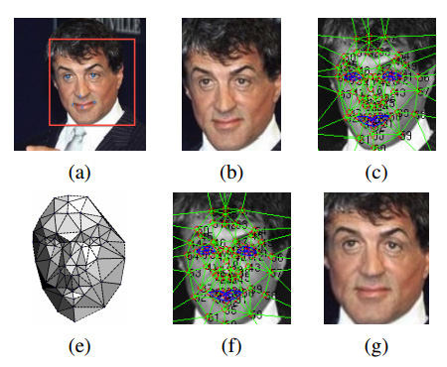
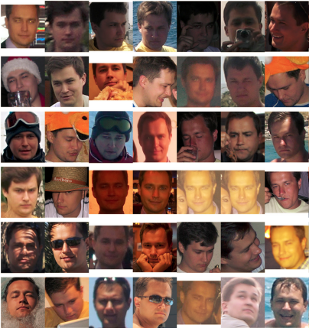
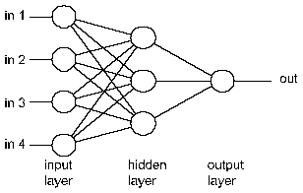
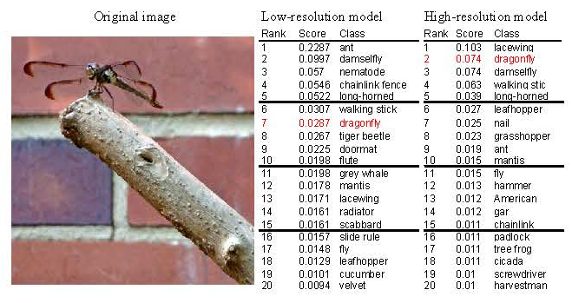
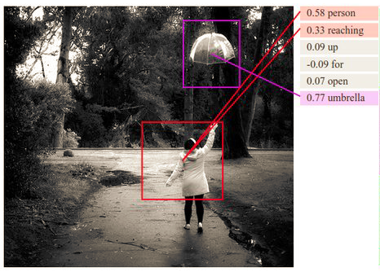
Neural-inspired algorithms have matured & are achieving success on recognition problems
DeepFace (Facebook) - Taigman et al. CVPR 2014
FaceNet (Google) - Schroff et al. CVPR 2015
http://www.cheshireeng.com/Neuralyst/nnbg.htm
DeepImage (Baidu) - Wu et al. 2015
Karpathy etc. CVPR 2014
Notes:
Fei Fei Li – Stanford; Lillian Lee – Cornell;
Diagram of multimodal Recurrent Neural Network generative model. The RNN takes a word, the context from previous time steps and defines a distribution over the next word in the sentence. The RNN is conditioned on the image information at the first time step.
Mnist
Shallow neural network
Current problems much more difficult Much more complicated netowrks and attempt at labeling contexts
Just deeper network and Computationally intensive

Slide 5
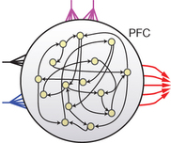
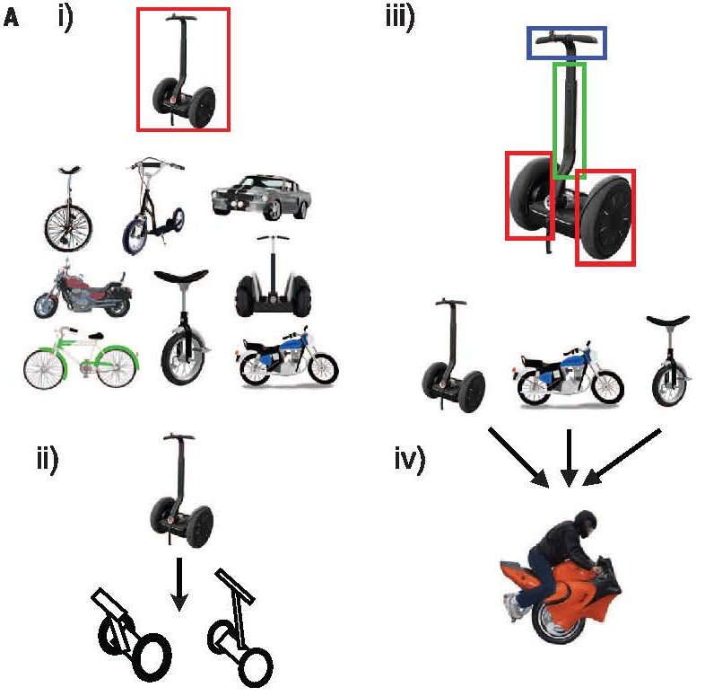
Modern machine learning only captures limited characteristics of neural computing
Temporal feature extraction via LSMs (Mante, Sussilo, Shenoy, Newsome, Nature 2013).
M. Smith talk: neural-inspired architecture for LSMs
Mante et al., Nature 2013, 503, 78
One-shot learning & generation of new concepts (Lake, Salakhutdinov, Tenenbaum, Science 2015).
Strengthen the connection between ML & neuroscience = neural machine learning
Lake et al., Science 2015, 350, 1332
Notes:
Mante – motion (black), color (blue), context (purple) – demonstrates input selection and integration in the prefrontal cortex
Bayesian program learning (BPL) – one shot learning where concepts are learned with one example, and additional concepts can be created by assembling parts of separate but already known concepts
Motivated machine learning, probably skip

Slide 6

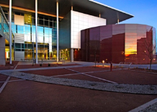
Neural computing at Sandia Labs
leverages a large research foundation
Neural Theory
Neural Computing Capabilities
Advanced Scientific & Data-Driven Computing
Computational Neuroscience
Neural-inspired Communication
Modeling & Simulation
Neural Machine-Learning Algorithms
Adaptive memory management
Neuro-Informatics
Formal Neural Computing Theory
Robust machine learning
UQ of Neural Algorithms
Enabling Hardware
Deployable National Security Applications
Configurable CMOS Neural Architectures
Non-Von Neumann Architectures
Cybersecurity
BMC - Memory Technology
Adaptive post-CMOS Neural Architectures
MESA Fab
Embedded Pattern Recognition Systems
Micro-Sensors
Smart Sensor Technology
Notes:
Hammer home simulartion (sensitivity and UQ from NW)
Other expertise form other places
Critical partners where expertice fits

Slide 7
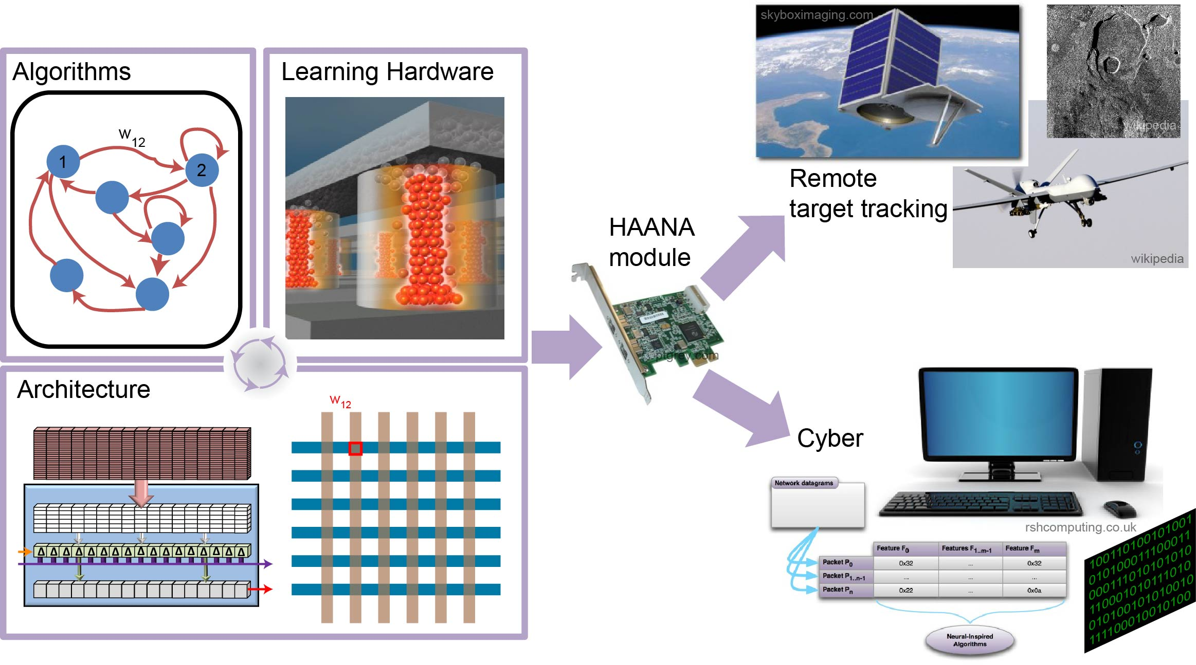
Hardware Acceleration of Adaptive Neural Algorithms (HAANA)
Notes:
Utilize neural-inspired algorithms and hardware to reduce computation time and power consumption in challenging data analysis problems
Easy to difficult problems left to right
Reformat dense features to convert to sparse for separation
2nd is not just static features, now we are looking at time features that add more information to the ability to categorize and separate
3rd is now with time, but it is not repetitive behavior, the data changes over time so we have to adapt to new

Slide 8
End of Moore’s Law-
Motivation for Neuromorphic Architectures
Post Moore’s Law effects
  Processing limited by power not complexity
  We can build it but we can’t cool it
Operational cost > capital costs
  Power, People & Space
However, economics still driving change
  Virtualization: Improved server utilization
  Cloud: Reduced user complexity & cost
Cloud/Virtualization approaching maturity

Slide 9
von Neumann Architecture
Strengths
  Ubiquitous & bullet proof
  Memory model offers maximum flexibility
Weaknesses
  Performance is power limited
  Primary culprit: Memory model
  Typically sub-optimal for high repetition tasks
    Floating point, ex. Nvidia
    Network Protocols

Slide 10
Changing Nature of Computing
Time value of data increasing rapidly
  Streaming Analytics fundamental to
    Financial industry: Banking, Wallstreet, fraud detection
    Social media: Google, Facebook
    Intelligence community: NSA, CIA, FBI
    etc.
Neuromorphic strength: ideal for streaming analytics
  Extraordinary at matching patterns
    FPGA >1,000x ops/watt vs IA server demonstrated
    ASIC >1,000,000x ops/watt projected
  Not power or routing limited

Slide 11
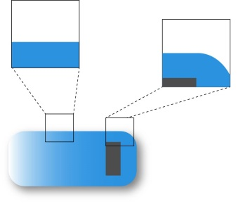

HAANA relies on applications to drive S&T
for algorithms, architecture, and hardware
Cyber, Imaging
Applications
Algorithms
Feature Extraction
Behavioral Trajectory Analysis
Response to Concept Drift
Sparse Coding
Temporal Coding
Adaptive Coding
Notes:
Considering the full range of problems to solve for real application progress
Looking for novel ways to represent features that are more amenable to neuromorphic algorithms
Using time as the critical element when processing repetitive behaviors that can be learned
Must be able to deal with concept drift to adapt to change world

Slide 12
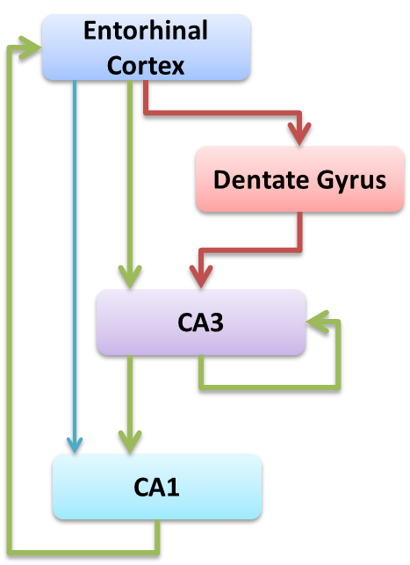
Neural-inspired algorithms: dentate gyrus pre-processing formats data for learning
Hippocampus model (Aimone et al)
Direct EC→CA3 is dense but weak (recall)
Path via DG is sparse and strong (training)
DG performs:
  Sparsity increases
  Pattern separation
Content-addressable Memory
Threat detection
Notes:
Sparsity of signal is critical for training CA3 network
Hippocampus model
Different region perform different functions
2 main issue:
1 sparsity increasing (separation again)
2 naturally leads to better pattern separation
New way of looking at hippocampus championed by our internal expert Brad Aimone
Switch order

Slide 13
Modeling the “sparsity transformation” in neurobiological systems
increased sparsity
DG increases sparsity of EC input – improved separation of features
Sparse coding decreases the normalized correlation for any pair of vectors, and thus increases the estimated ‘sparsity’.
Severa et al, accepted Neural Computation 2016
Notes:
Phi = sparsity of F (smaller phi=more sparse), which is the function that maps from EC activity space to DG activity space; p = size of a subset of neurons; n=# of neurons
Even small values for p lead to significant decreases in the normalized dot products.
EC representation is broad and overlapping
DG has transformed to sparse representation that is no longer overlapping
Also separates activity spaces for great classification
Gloss over graph

Slide 14
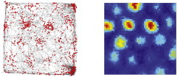
Neurogenesis increases coding flexibility
Adult neurogenesis improves information capacity
Grid cells (EC to DG) encode spatial dimensions
Dentate code is compatible with the introduction of new neurons and the refinement of old neurons
Mixed heterogeneous code allows for adaptation to novel inputs, increased capacity
Dieni et al, Nature Comm 2016
Giocomo et al, Neuron 2011
Severa et al, accepted Neural Computation 2016
Notes:
DG develops new neurons throughout life: New neurons—Broadly tuned; Mature neurons—Tightly tuned
Looking at hippocampus and formalizing algorithms based on hippocampus for CAM and temporal pattern recognition; 1st example – W. Severa; NG inspired sparse coding problem – purple (known data and existing code), broad code (pink bubbles) cover more space; heterogeneous code of tightly-tuned code (purple) and broad code (pink) will enable you to cover all data;
Upshot: brain has an ability to encode novel information by utilizing
Left shows stained new cells forming with abilty to learn new information
New neurons can’t cover all space, so best model is to fully utilize narrow mature neurons with broad new neorons to cover the information space

Slide 15
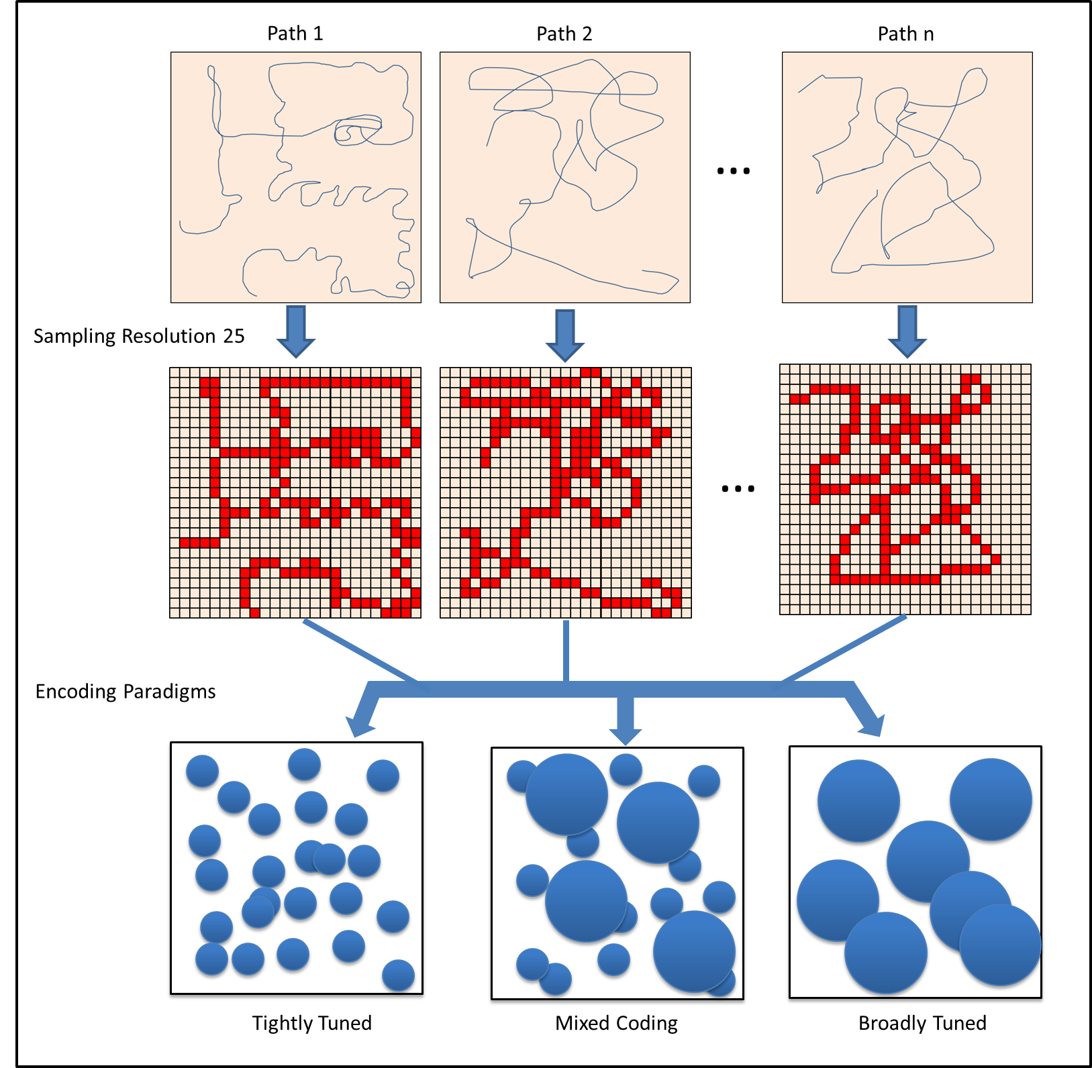
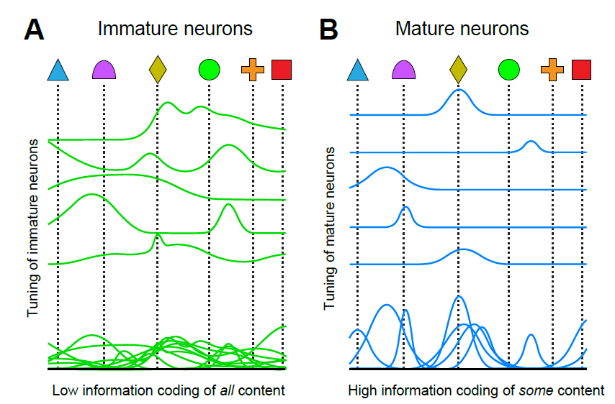
Exploring the impact of neural information content in a real-world application
- Estimate the neural information content in place cell encoding of spatial locations
- Map information content to the neural space (resolution, efficiency)
- Examine the impact of neurogenesis on encoding and information content
Aimone, Deng and Gage, Neuron 2011
15
Notes:
Experimental computational paradigm to explore implications of mixed coding & neurogenesis
Hippocamous does not have perfect resoluation; Bottom row – small circles are neurons that only fire when hit (older neurons – mature, tightly tuned); large circles are immature neurons;
Had large number of sample paths for complete coverage of the field;
This experimental paradigm allows us to generate neural spiking outputs which we can then run our compression techniques on to approximate the information content in a controlled manner

Slide 16
Algorithmic approaches
to handle concept drift in data
Cyber, Imaging
Feature Extraction
Behavioral Trajectory Analysis
Response to Concept Drift
Sparse Coding
Temporal Coding
Adaptive Coding
ReRAM Crossbar
Processing Units
Adaptive Architecture
System
Modeling
Device
Modeling
FPGA
Hybrid
Materials Chemistry
Device Design

Slide 17
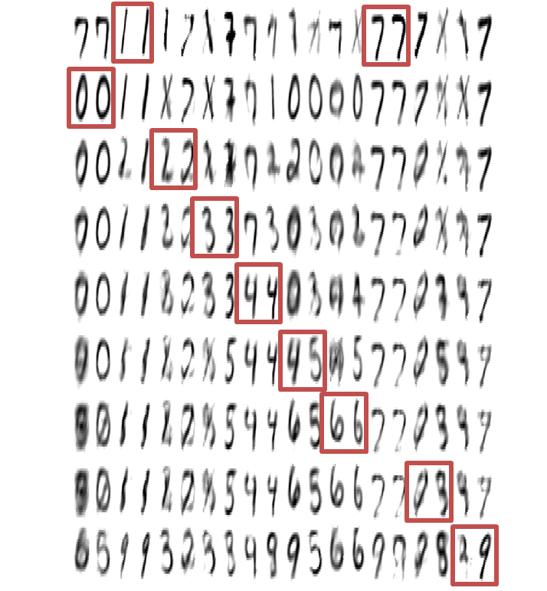




Data-driven computing methods are limited… by data; auto-encoder for data reconstruction
9
0
5
6
200
3
4
8
1,7
2
250
00112233445566778899
300
784
Encoding / classification path
Decoding / reconstruction path
Draelos et al, ICLR 2016
17
Notes:
Autoencoder: feeding in digits to convert to a known representation.
Trained for 7 and 1
Each row is training on the next digits, see degredataion of old learned.

Slide 18
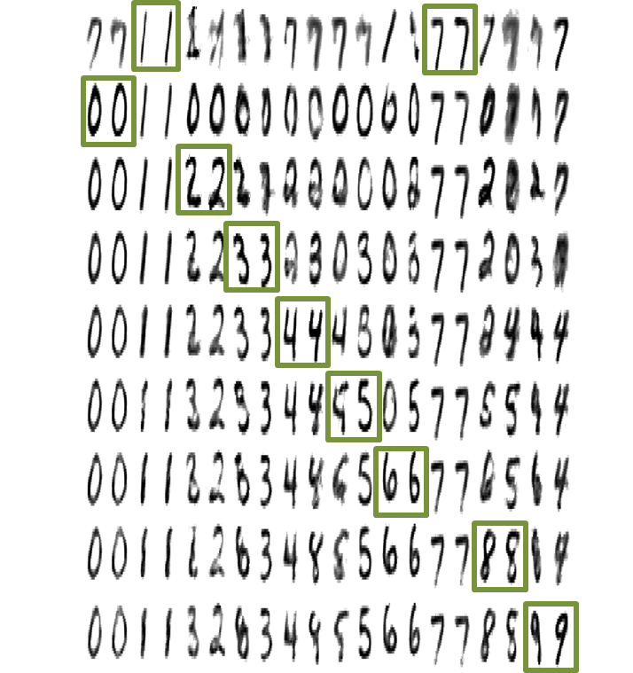


“Neurogenic deep learning” enables adaptation to changing data
9
0
5
6
200
3
4
8
1,7
2
250
00112233445566778899
300
784
Encoding / classification path
Decoding / reconstruction path
Draelos et al, ICLR 2016
18
Notes:
Notice that most features do not degrade as intelligent augmentation of infrastructure theat model neurogenesis.

Slide 19
Extracting features from cyber data
Cyber, Imaging
Feature Extraction
Behavioral Trajectory Analysis
Response to Concept Drift
Sparse Coding
Temporal Coding
Adaptive Coding
ReRAM Crossbar
Processing Units
Adaptive Architecture
System
Modeling
Device
Modeling
FPGA
Hybrid
Materials Chemistry
Device Design

Slide 20
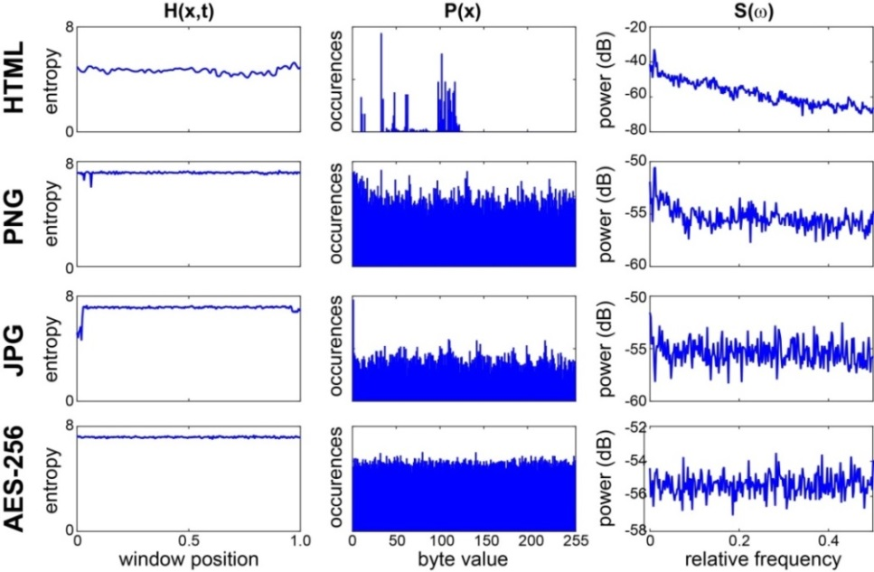
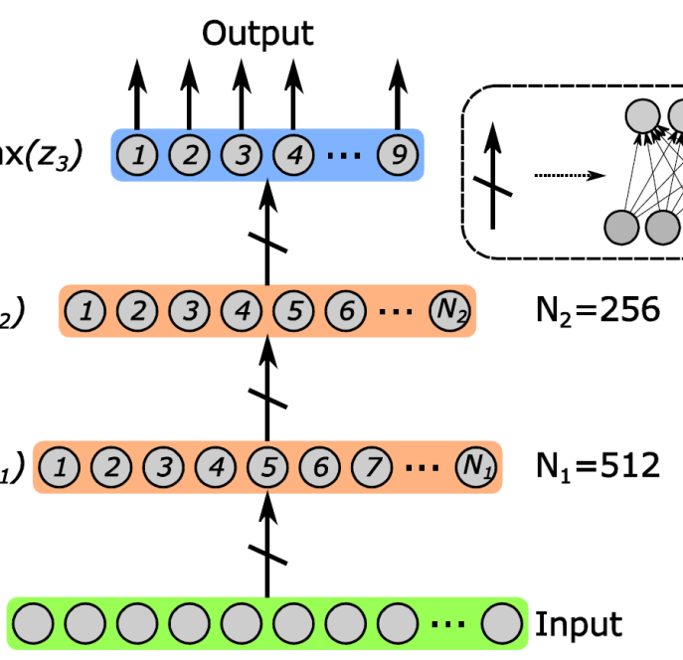
Cyber data identification
with a deep neural network classifier
Entropy
Byte Value
PSD
*.elf
*.aes
*.pdf
*.html
*.gzip
*.gif
*.jpeg
*.png
*.doc
Predicted Class
 |  | HTML | PNG | JPEG | GIF | PDF | DOC | ELF | GZIP | AES
Actual Class | HTML | 100
 | PNG |  | 91 | 1 |  | 1 | 1 | 1 | 1 | 4
 | JPEG |  | 1 | 99
 | GIF |  |  |  | 100
 | PDF |  | 1 | 3 | 1 | 95
 | DOC |  | 1 |  |  |  | 99
 | ELF |  |  |  |  |  |  | 100
 | GZIP |  |  |  |  |  |  |  | 100
 | AES |  | 5 |  |  |  |  |  |  | 95
Cox, Aimone, James; Complex Adaptive Systems, Nov. 2015; Procedia Comp Sci 61, 349
Notes:
Identification of file types using entropy, symbol distribution, and PSD
Combined → 97.44% accuracy
Feed-forward neural network, supervised learning – output layer has a softmax activation
H – sliding window entropyv, P – distribution of byte values, S(w) - power spectral density
4500 files, stripped headers,
Found 3 features that when fed into the network, provided best categorization.
This is supervised learning
Deep learning (based on neural understand) mechanism applied to our cyber space

Slide 21
Dynamic learning applications in cyber data
Cyber, Imaging
Feature Extraction
Behavioral Trajectory Analysis
Response to Concept Drift
Sparse Coding
Temporal Coding
Adaptive Coding
ReRAM Crossbar
Processing Units
Adaptive Architecture
System
Modeling
Device
Modeling
FPGA
Hybrid
Materials Chemistry
Device Design

Slide 22
Tracking the Known: Bracketing Previously Identified Threats
Architecture Core
S(t)
Algorithms Core
PCRE
known
rules
Unlabeled
Feature Extraction
Adaptivity, temporal coding
Potential, unknown signatures
Historical Bulk Collect
Known Bad
Hardware Accelerated Learning
Learning Hardware Core
Candidate Threats
Validation
Candidate PCRE Rules
8

Slide 23
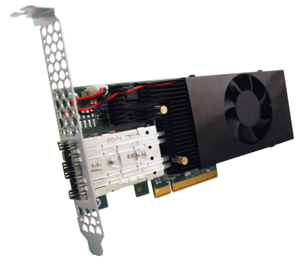
Accelerate PCRE processing with
Temporal Processing Unit (TPU)
Collaboration with Lewis Rhodes Labs (LRL)
Patented neural inspired architecture for temporal processing
Neuromorphic
Processor
Policy
Recognition:
Find Ex_{n}, n>>1
Behavioral:
Find !Ex_{n}, n>>1
(Un)Structured
Input Stream(s)
PCIe
Structured Output
Metadata
Stream
Behavior
Match
Classification
Filter
Prediction
Pipeline
Notes:
TPU is a policy engine. Allows unstructured data input and efficiently searches all data

Slide 24
TPU Integration for PCRE Processing
API for usability
  Hide complexity so no neural knowledge required by practitioners
  Waterslide is an opensource highly optimized stream processing code
    Hear all about this from Karl Anderson tomorrow
    Seamlessly integrated TPU API in a mater of weeks
Significant PCRE performance improvement
  Demonstrated 1000X Ops/Watt gain
  David Follett will tell the rest of the story tomorrow
Seamlessly integrated in the Tracking the Known testbed
TPU product “Neuromorphic Cyber Microscope” is an R&D100 finalist in 3 categories

Slide 25
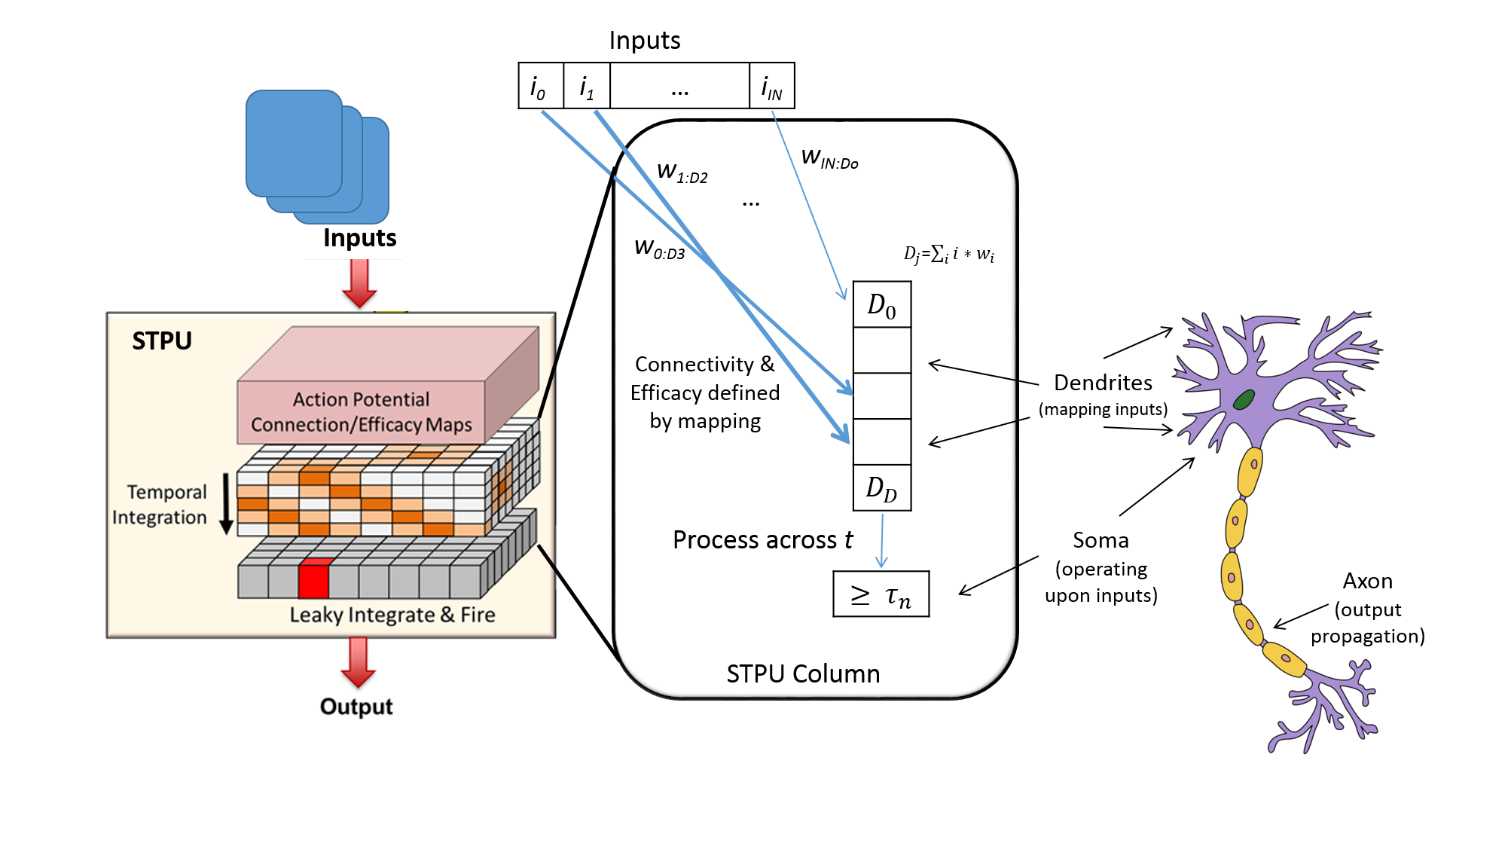
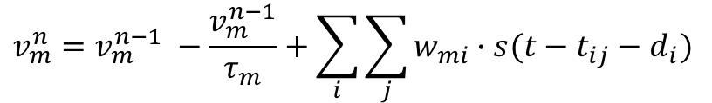
Spiking Temporal Processing Unit (STPU)
$$v_{m}^{n}=v_{m}^{n−1} −\frac{v_{m}^{n−1}}{τ_{m}}+\sum_{i}{\sum_{j}{w_{mi}∙s(t−t_{ij}−d_{i})}}$$

Slide 26


Liquid State Machine
Developed by Wolfgang Maass
Reservoir computing
  Echo State Machines
  Liquid State Machines
Different items at different locations at different times
Differences between the patterns are amplified by the liquid
Mimics brain functionality
Supervised learning
Maass, W., Markram, H., On the Computational Power of Recurrent Circuits of Spiking Neurons, Journal of Computer and System Sciences 69(4): 593-616, 2004.

Slide 27
Demonstrated LSM Applications
Speech and audio recognition
Image Pattern Recognition
Music Classification
Robot Path Planning
Fingerprint Scanners
Facial emotion recognition

Slide 28
Mapping LSMs onto the STPU
Goals:
  Implement the rich dynamics of a LSM efficiently
  Recurrence
  Exponential synaptic response functions
  Drives improvements to STPU architecture
Currently implemented LSM on manually coded STPU
Demonstrated speech recognition with minimal parameter tuning using ridge regression
Comparison with Zhang et al. 2015:
  Use state variables to keep track of synaptic responses. Time constants are binary (division becomes bit shifting)
  STPU uses weights to put values into the temporal stack

Slide 29
Extracting features from cyber data
Cyber, Imaging
Feature Extraction
Behavioral Trajectory Analysis
Response to Concept Drift
Sparse Coding
Temporal Coding
Adaptive Coding
ReRAM Crossbar
Processing Units
Adaptive Architecture
System
Modeling
Device
Modeling
FPGA
Hybrid
Materials Chemistry
Device Design

Slide 30

Spiking network algorithm for computing cross-correlations in particle image velocity (PIV)
Data can be stored in the dynamics of a network
Dynamics allow for trade-off: Time ↔ Neurons
Neural algorithms can achieve constant time
Efficient implementation on the STPU
Example 2D flow-field (t₀ an t₁)
Severa et al, accepted ICRC 2016
Notes:
F and G are our two datasets for which to compute their cross-correlation (convolution). A = inner neurons compute the inner product; B = integrators that collect spikes; scheduling neuron fires timesteps to B; first neuron in B to fire will be the delay that corresponds to the greatest overlap;
Fourier transform – O(nlogn); Theoretically we can do this computation in constant time; do pairwise comparison for constant time to calculate maximum; and perform this with lower energy;

Slide 31
Spiking network algorithm for computing cross-correlations in particle image velocity (PIV)
Data can be stored in the dynamics of a network
Dynamics allow for trade-off: Time ↔ Neurons
Neural algorithms can achieve constant time
Efficient implementation on the STPU
Example 2D flow-field (t₀ an t₁)
Severa et al, accepted ICRC 2016
Notes:
F and G are our two datasets for which to compute their cross-correlation (convolution). A = inner neurons compute the inner product; B = integrators that collect spikes; scheduling neuron fires timesteps to B; first neuron in B to fire will be the delay that corresponds to the greatest overlap;
Fourier transform – O(nlogn); Theoretically we can do this computation in constant time; do pairwise comparison for constant time to calculate maximum; and perform this with lower energy;

Slide 32

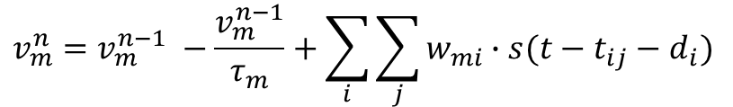
Using Spike Timing of STPU
SpikingSort: input = $\left\{1, 0, 6, 3, 4, 7, 6, 9, 1, 2, 6\right\}$
maximum
median
minimum
Sorted integers: $\left\{9, 7, 6, 6, 6, 5, 3, 2, 1, 1, 0\right\}$

Slide 33
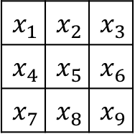
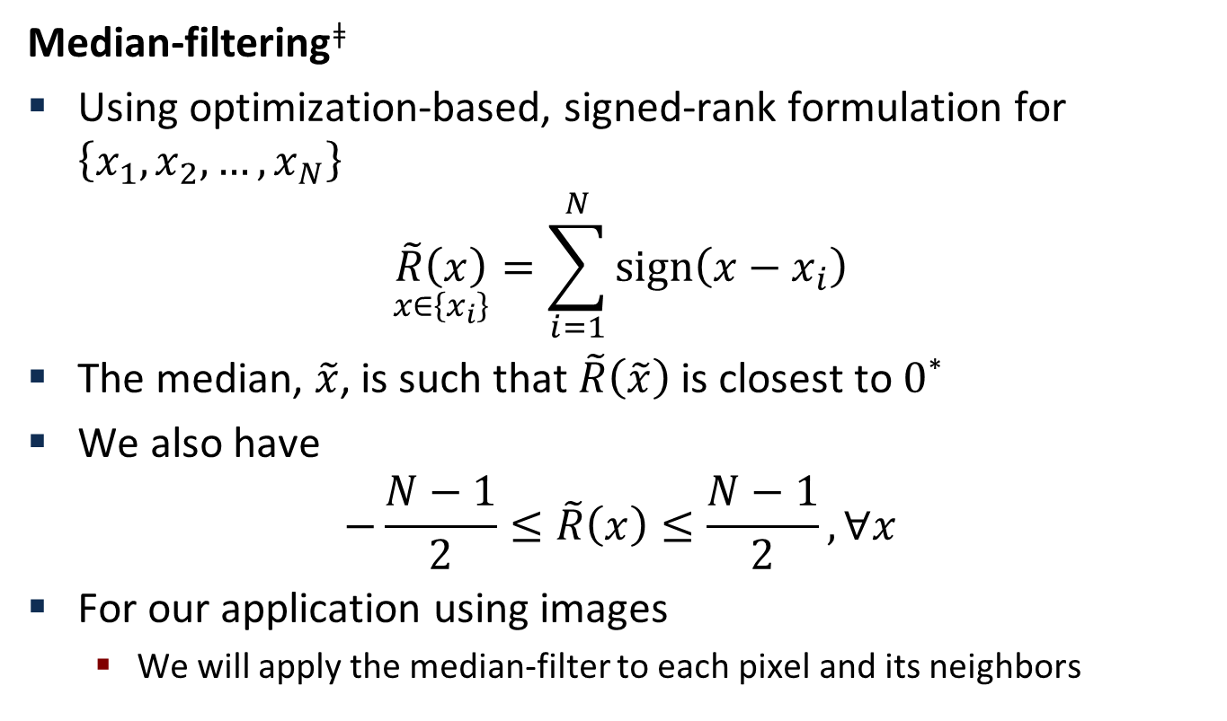
Practical Application on STPU
Median-filtering^{ǂ}
Using optimization-based, signed-rank formulation for $\left\{x_{1},x_{2},…,x_{N}\right\}$
$$\underset{x∈\left\{x_{i}\right\}}{\tilde{R}\left(x\right)}{=\sum_{i=1}^{N}{sign\left(x−x_{i}\right)}}$$
The median, $\tilde{x}$, is such that $\tilde{R}\left(\tilde{x}\right)$ is closest to $0$*
We also have
$$−\frac{N−1}{2}≤\tilde{R}\left(x\right)≤\frac{N−1}{2}, ∀x$$
For our application using images
  We will apply the median-filter to each pixel and its neighbors
$$x_{1}$$ | $$x_{2}$$ | $$x_{3}$$
$$x_{4}$$ | $$x_{5}$$ | $$x_{6}$$
$$x_{7}$$ | $$x_{8}$$ | $$x_{9}$$
^{ǂ}See Verzi et al., 2016
*See Oja, 2010

Slide 34
Median-filtering
Original image
SpikingSort network using decay

Slide 35




Median-filtering
Noisy image
percent pixels different = $9.85$
number different pixels = $6651$
total difference = $780735$
average difference = $117.386$

Slide 36




Median-filtering
Median-filtered image (1st iteration)
percent pixels different = $67.7$
number different pixels = $45704$
total difference = $578625$
average difference = $12.6603$

Slide 37
Median-filtering
Median-filtered image (1st iteration)
As of yesterday:
STPU API working with N2A neural framework
percent pixels different = $67.7$
number different pixels = $45704$
total difference = $578625$
Architecture and API support multiple applications
average difference = $12.6603$

Slide 38
Steganography with the STPU
Steganography is practice of concealing data within data
STPU with phase-coding allows us
  To learn original data
    Could be “ground truth”
    Could be one of two (or more) data sources
  To perform phase-differencing with incoming data source

Slide 39
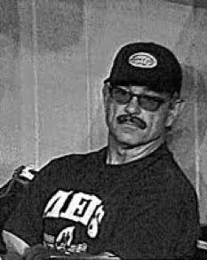
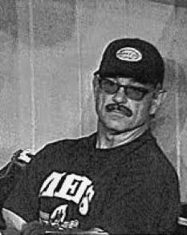
Steganography example
Who is hiding in this picture?
Original
Copy with hidden data

Slide 40
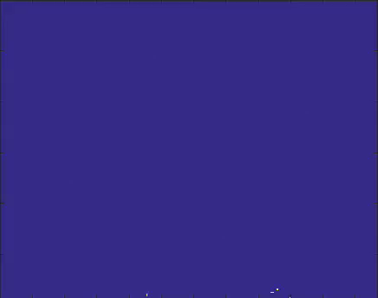
Phase-differencing demonstration
Aggregation phase-difference between two images

Slide 41
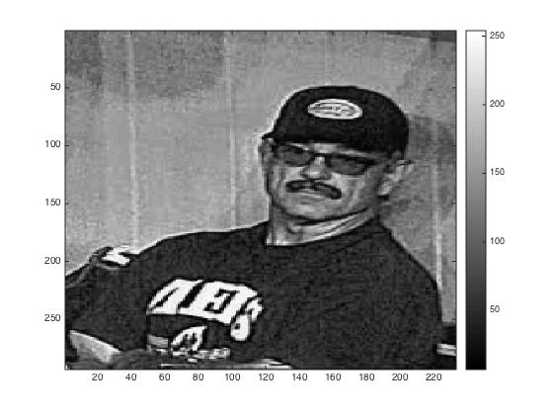
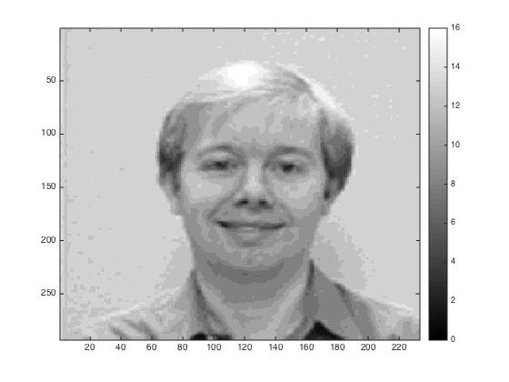
Phase-differencing demonstration
Phase-differencing
Copy with hidden data
Phase-difference image

Slide 42
STPU Shows Great Promise
Neural architecture extremely flexible
  Many applications, same architecture
High performance, parallel architecture recently demonstrated in FPGA
Filing patent on method to increase the effective neuron count with no performance penalty
  Trade simple memory resources for neuron density
As of yesterday:
  STPU hardware API working with N2A neural framework

Slide 43
HAANA: Research to Reality
STPU
Version 2
Theoretically sound?
Can we build it?
TPU
Version 4
Does value translate
to Applications?
Mission Impact?
Commercial Impact?
Critical Innovation
at each stage

Slide 44
Learning crossbar performance assessment
Cyber, Imaging
Feature Extraction
Behavioral Trajectory Analysis
Response to Concept Drift
Sparse Coding
Temporal Coding
Adaptive Coding
ReRAM Crossbar
NPUs
Adaptive Architecture
System
Modeling
Device
Modeling
FPGA
Hybrid
Materials Chemistry
Device Design
Notes:
Behavior – what should I expect next
Concept drift – model changes over time

Slide 45
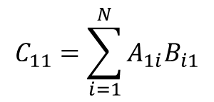
Matrix multiplication
A₁₁ A₁₂ A₂₁ A₂₂
A₁₃ A₁₄ A₂₃ A₂₄
B₁₁ B₁₂ B₂₁ B₂₂
B₁₃ B₁₄ B₂₃ B₂₄
C₁₁ C₁₂ C₂₁ C₂₂
C₁₃ C₁₄ C₂₃ C₂₄
A₃₁ A₃₂ A₄₁ A₄₂
A₃₃ A₃₄ A₄₃ A₄₄
B₃₁ B₃₂ B₄₁ B₄₂
B₃₃ B₃₄ B₄₃ B₄₄
C₃₁ C₃₂ C₄₁ C₄₂
C₃₃ C₃₄ C₄₃ C₄₄
$$C_{11}=\sum_{i=1}^{N}{A_{1i}B_{i1}}$$
Matrix Multiply is the core operation of many
Applications such as Neural Networks

Slide 46
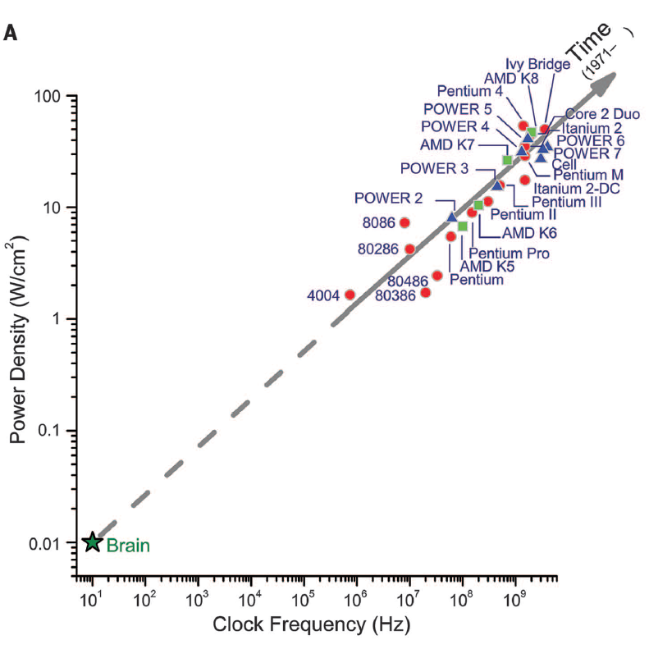
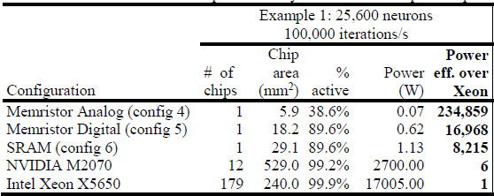
Use hardware acceleration (existing or novel technology)
to speed-up data processing in neural-inspired algorithms
k
Lee et al. Proc World Cong Eng Comp Sci 2013
j
Agarwal et al, IJCNN 2016
Merolla, P. A. et al. Science 345, 668-673 (2014)
T. Taha, et al., Proc. IEEE Intl. Joint Conf. on Neural Networks, 2013.
Notes:
FPGA matrix multiply acceleration

Slide 47
Translating non-spiking neural network algorithms into hardware
Network
V^{T}W=I
RRAM analog crossbar
V₁
V₂
V₃
W_{1,1}
W_{1,2}
W_{1,3}
W_{2,1}
W_{2,2}
W_{2,3}
=
w₁₁
w₁₂
w₃₁
W_{3,1}
W_{3,2}
W_{3,3}
k
w₂₁
w₂₂
w₃₂
I₁=ΣV_{i,1}W_{i,1}
I₂=ΣV_{i,2}W_{i,2}
I₃=ΣV_{i,3}W_{i,3}
w₃₁
w₃₂
w₃₃
V
W
V₁
w₁₁
w₁₂
w₃₁
G_{1,1}
G_{1,2}
G_{1,3}
j
V₂
w₂₁
w₂₂
w₃₂
G_{2,1}
G_{2,2}
G_{2,3}
V₃
w₃₁
w₃₂
w₃₃
G_{3,1}
G_{3,2}
G_{3,3}
I
I₁=ΣV_{i,1}G_{i,1}
I₂=ΣV_{i,2}G_{i,2}
I₃=ΣV_{i,3}G_{i,3}
Agarwal et al, IJCNN 2016

Slide 48
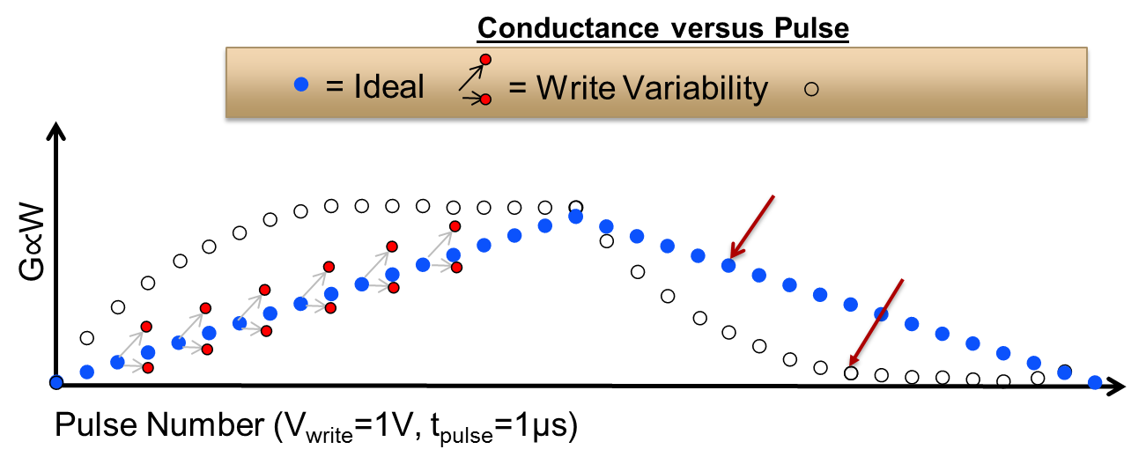
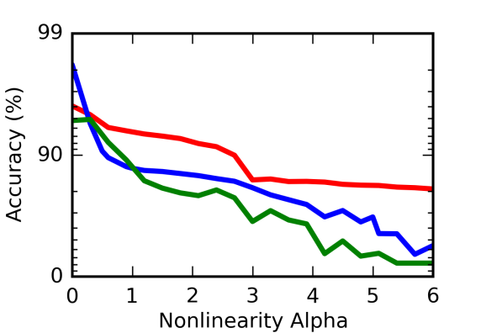
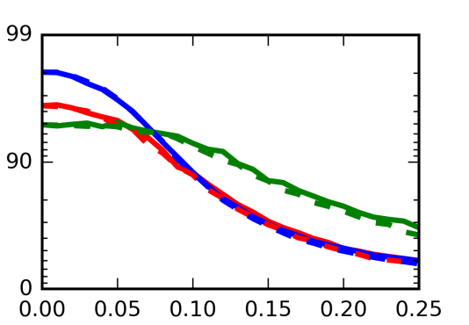
Resistive memory device characteristics
are non-ideal
= Nonlinearity
High training accuracy requires:
Low Write Variability
Low Write Nonlinearity
Low Asymmetry
Low Read Noise
Read Noise
Write Noise
Nonlinearity
Large Images
Gaussian
σ_{WN}=0
RTN
Accuracy (%)
Small Images
Small Images
File Types
File Types
Large Images
Nonlinearity (ν)
Normalized Sigma (σ_{RN})
Agarwal et al, IJCNN 2016

Slide 49
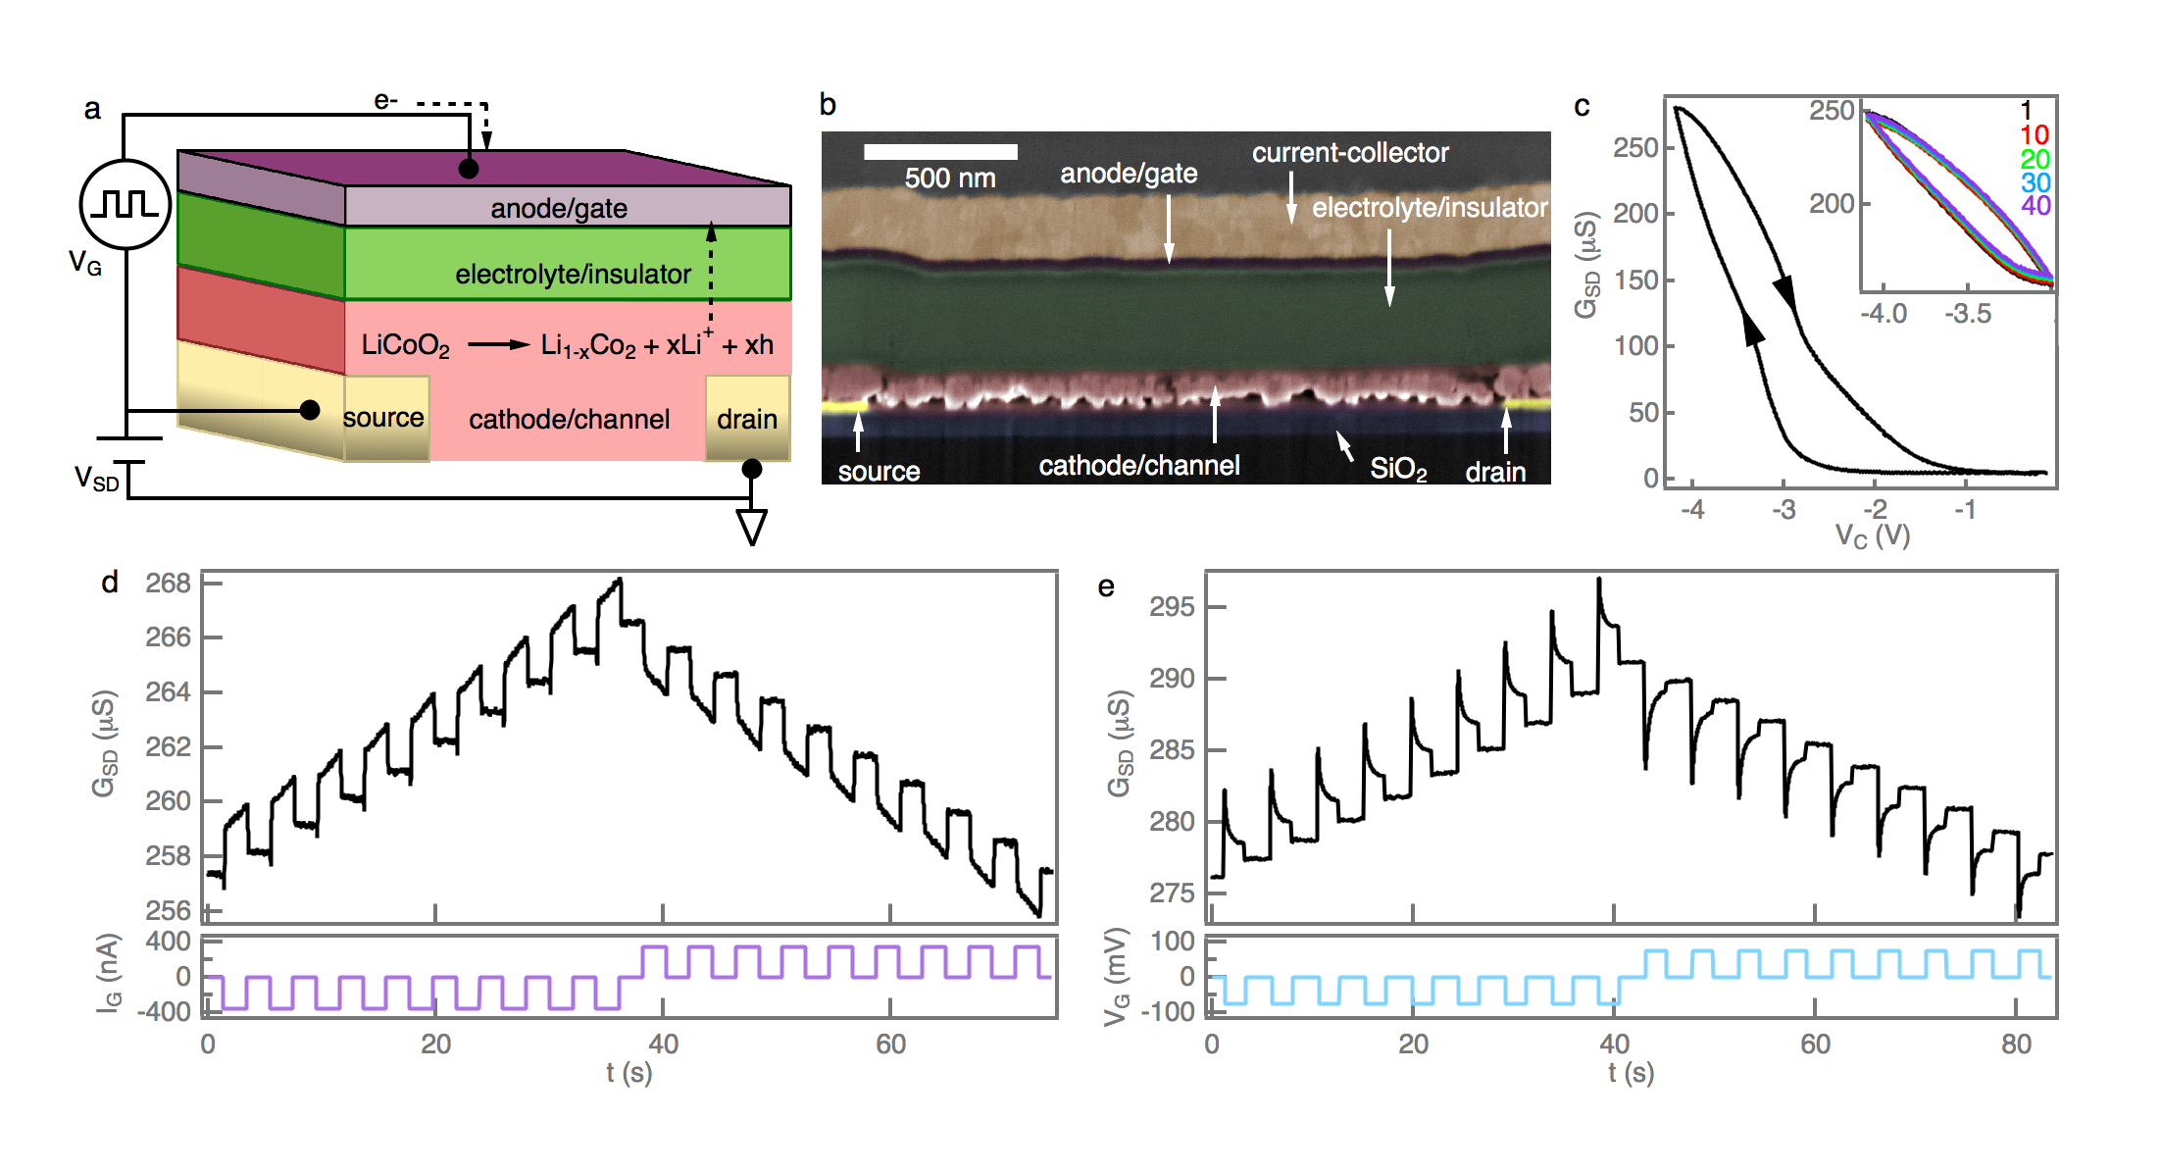
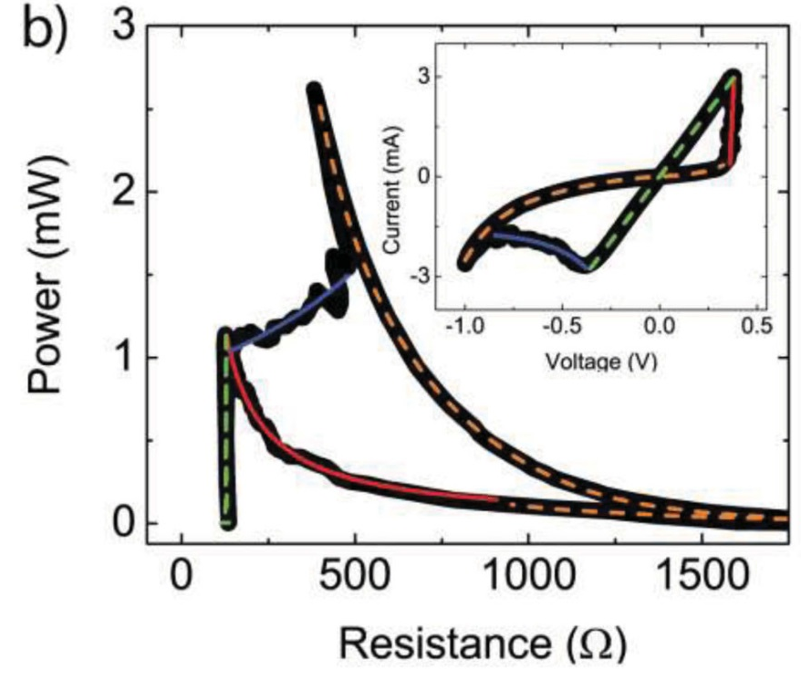
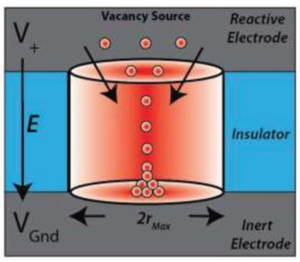
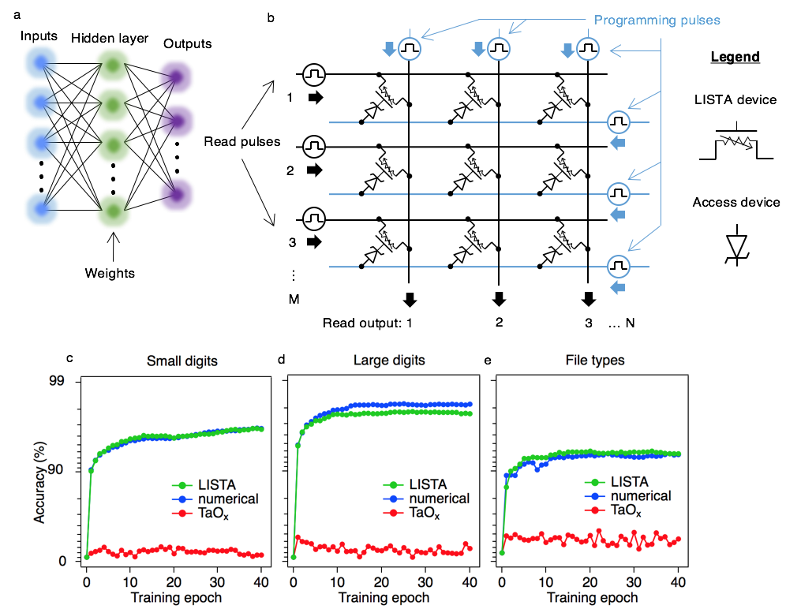
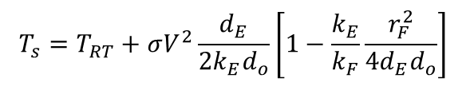
Designing, modeling, and fabricating devices with improved neural algorithm characteristics
ON switching, ON state, OFF switching, OFF state
99
Accuracy (%)
Filament surface temperature (T_{s}):
$$T_{s}=T_{RT}+σV^{2}\frac{d_{E}}{{2k}_{E}d_{o}}\left[1−\frac{k_{E}}{k_{F}}\frac{r_{F}^{2}}{{4d}_{E}d_{o}}\right]$$
90
Mickel, Lohn, James, and Marinella, Adv Mater, 26, 4486, 2014
Landon et al., APL 2015, 107, 023108
Fuller et al., Adv Mater 2016, in press
Notes:
Left: Heat flow model of filamentary resistive switching in Ta_{x}O_{y} films; Model has been demonstrated to apply to a range of resistive switching materials from other labs (HfO_{x}, TiO_{x}, HfO_{x}/ZrO_{x}); Thermal conduction in the devices are carried out by phonons and charged carriers
Tatalum oxcide old bad charactierstics
Lithium Cobalt Oxcide
This slide needs fixing!!!!! Bottom right

Slide 50
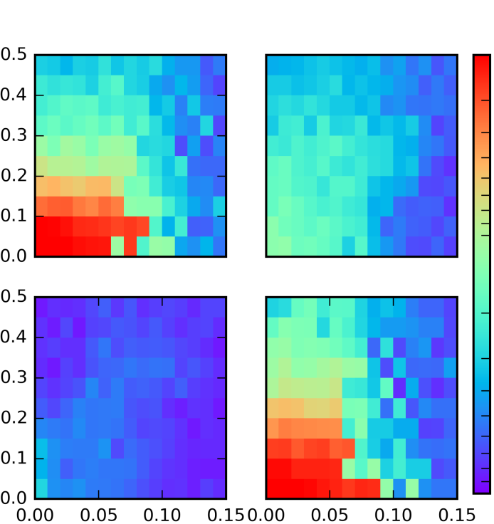
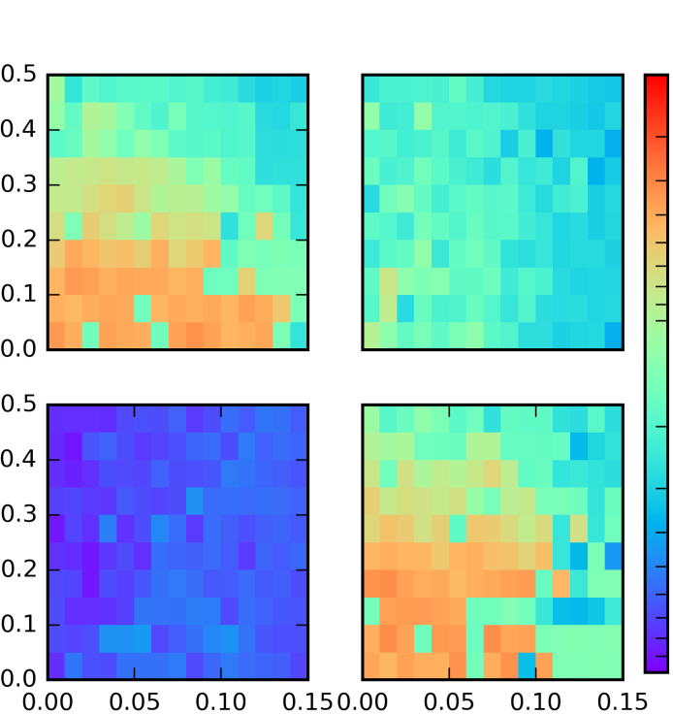
Combined impact of device non-idealities on algorithm performance
MNIST
Accuracy
File Types
Accuracy
Linear
Asymmetric, ν = 1
98
Linear
Asymmetric, ν = 1
98
Write Noise (σ_{WN})
Write Noise (σ_{WN})
90
90
Asymmetric, ν = 5
Symmetric, ν = 5
Asymmetric, ν = 5
Symmetric, ν = 5
Write Noise (σ_{WN})
Write Noise (σ_{WN})
0
0
Read Noise (σ_{RN})
Read Noise (σ_{RN})
Read Noise (σ_{RN})
Read Noise (σ_{RN})
Notes:
All of this based on our very accurate simulations that we have developed from HAANA.

Slide 51
Summary
HAANA is a broad based S&T program
Neural technologies are fundamentally streaming oriented
  Although matrix multiply very interesting to ASC applications!
Architectures
  Temporal Processing Unit; 3 orders ops/watt improvement
  Spike Time Processing Unit accelerating applications
    Liquid State Machine
    Sorting/image filtering
Algorithms
  Adaptive learning techniques developing
Material science
  Effective resistive memory matrix multiply material identified
    Potential orders of magnitude power reduction
Contact: Kevin Dixon (krdixon@sandia.gov)

Slide 52
Thanks for your time!
Questions?

