Slide 1
Machine Learning at the Edge: Impact on Analytics, Business, and Privacy
Christopher Krieger
Neuromorphic Computation Research Group
Laboratory for Physical Sciences
Notes:
Work with SWAP and Cost limited devices. Hoping to find that Edge computing would improve privacy. This talk is about the journey to explore that space.

Slide 2
Breakdown of Talk: 3… 2… 1…
Explore impacts from three perspectives …
Analytics / Technology, Business, Privacy
… at two points in time …
Before and after Edge Computing
… using one example use case
Multilingual speech to text

Slide 3
Project FIFEDOM: Concept
FIFEDOM
Build a system that:
Converts speech to text in several languages (English, Korean, Mandarin, French)
Converts text in those languages to English
Searches the English text for keywords
Using:
Two interns, two months
Google APIs…
… then open source tools running on low power, low cost edge devices

Slide 4
Before the Edge
Notes:
5 minute mark

Slide 5
Today’s ML Analytics
Data Centers / HPC Installations
Economies of scale
Aggregation and Batching
Many queries/tasks can be processed together
Latency is balanced with batch size
Network Required
User data has to be sent to data center
“Internet of Things” unsurprisingly depends on the Internet
Notes:
Google Cloud Compute Engines or Amazon EC2 Instances

Slide 6
Today’s Business Models Regarding Personal Data
Buying Your Data
Amazon Prime Tracking
Google API deals
Bartering for Your Data
Services in Exchange for Your Data
Your location in exchange for mapping/routing
Your video preferences in exchange for a YouTube video
Your query in exchange for search results

Slide 7
Notes:
10 minutes

Slide 8
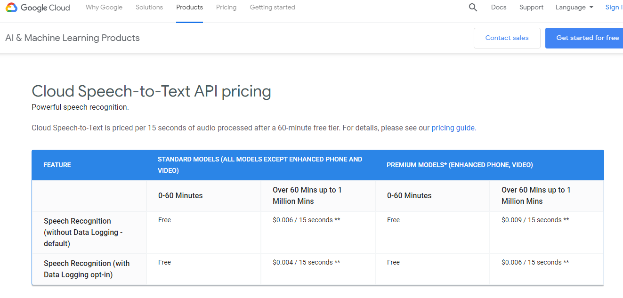
Sell Your Speech for 33% Off

Slide 10
Today’s (Default) Privacy

Slide 11
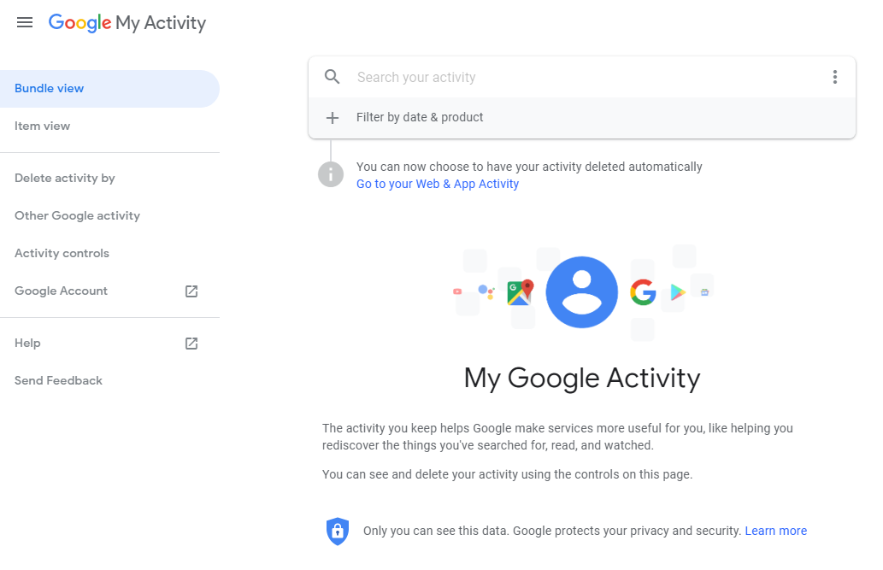
My Activity

Slide 12
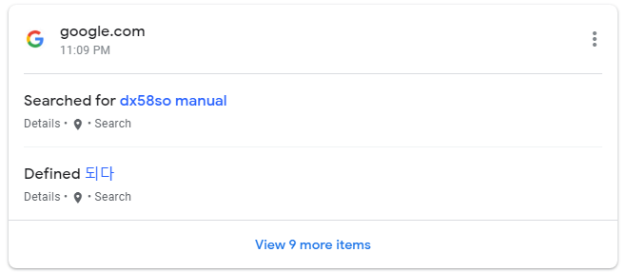
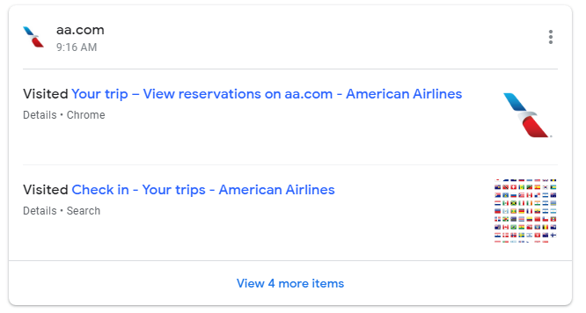
My Activity

Slide 13
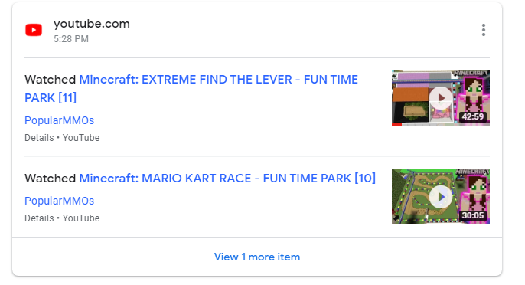
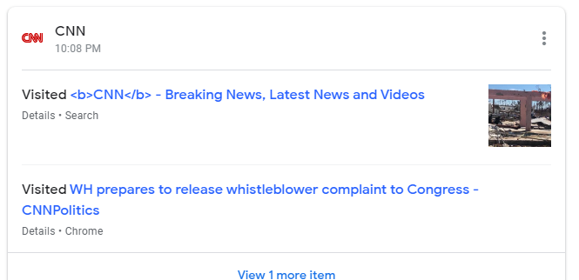
My Activity

Slide 14
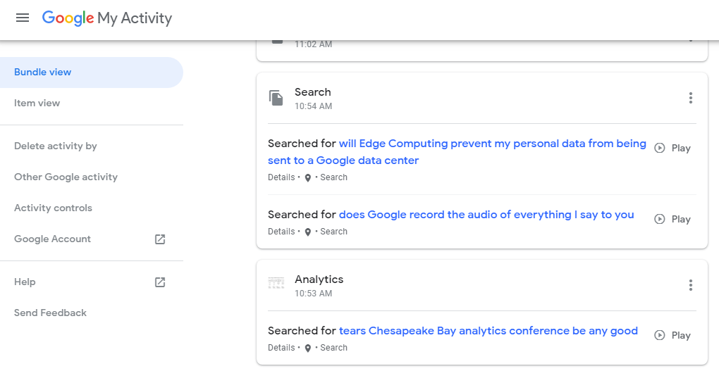
My Activity

Slide 15
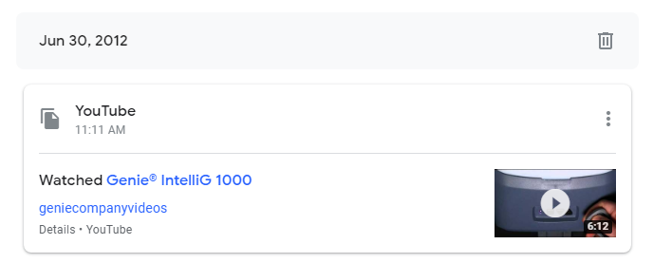
How Far Back
Notes:
21 minutes

Slide 16
Project FIFEDOM: Status Today
FIFEDOM
Built a system that:
Converts speech to text in several languages (English, Korean, Mandarin, French)
Converts text in those languages to English
Searches the English text for keywords
Using:
Two interns spent two months, one intern still working part time
Google APIs version done and evaluated

Slide 17
Example Speech to Text: English
Human: Tom came on Monday and went back home the next day.
Google: Tom came on Monday and Wednesday back home the next day.
Google US-EN Word Error Rate: 4.9%

Slide 18
Example Speech to Text: Korean
Human: “먹었어 ?“ "응.“ "- 어때 ?“ "쓴. 엄청 쓴." "그게 다야 ?”
English: "Did you drink it?" "Yeah." "How was it?" "Bitter. Very bitter." "That's it?"
Google: "먹었어. 어때 ? 엄청 없어 그게 다야 ?”
English: Did you drink? [ ] What did you think? [ ] Very no. “That’s all?”

Slide 19
After the Edge

Slide 20
Edge Computing
“In order to reach a future situation of ‘AI everywhere’, we have to deal with huge amounts of data generated and make sure organizations are equipped with what they need to make effective use of the data and process them where they are collected.”
--Naveen Rao
General Manager,
Intel’s artificial intelligence products group
Notes:
https://www.reuters.com/article/us-tech-intel-israel/intel-launches-first-artificial-intelligence-chip-springhill-idUSKCN1VA1LS
28 minutes

Slide 21
Where are the data collected ?
Point of Sale Systems
Security Cameras
Cell Phones
GPS, Accelerometers, Cameras, Microphones, Light Sensors, Compasses, …
Drones
GPS, Accelerometers, Cameras, Microphones, Light Sensors, Compasses, …
Cars
Scientific Instruments
Seismometers, Thermometers, Voltmeters, Anemometers, Radiotelescopes, …
Network Traffic
Routers, Network interfaces, Firewalls, …

Slide 22
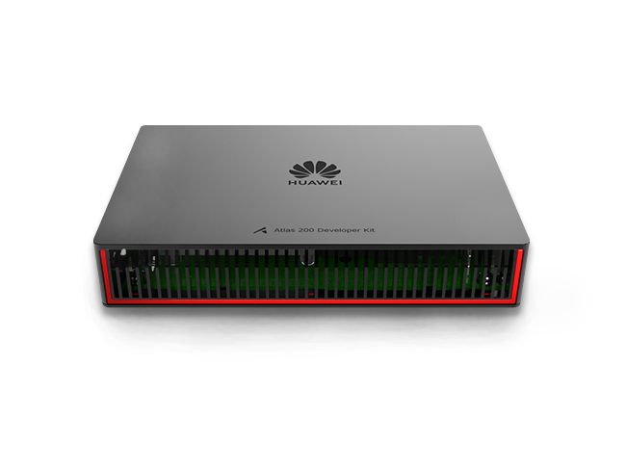
State of the Art Edge Devices Huawei Ascend 310
Huawei Ascend 310
Atlas 200 DK Developer Kit
8 TFLOPS FP16, 16 TOPS Int8
8 GB Ram
< 20 W, Typically 9W
Pricing TBD
Notes:
30 minutes

Slide 23
State of the Art Edge Devices Google Coral Board / Edge TPU
Google EDGE TPU
CORAL Developer Kit
4 TOPS INT8 @ 2W
1 GB Ram
56mm x 85mm
Price: $149

Slide 24
State of the Art Edge Devices Nvidia Nano
Nvidia Nano
GPU: 128-core NVIDIA Maxwell™
CPU: Quad-core ARM® A57
472 GFLOPS
4 GB Ram
2-5 Watts
Price: $99

Slide 25
State of the Art Edge Devices SiPeed
SiPeed K210 Dev Board with MAIX-1 Chip
KPU AI Accelerator & 2 RISC-V Cores
KPU believed to be based on Nvidia DLA?
.25 TOPS @ 0.3 W
25mm x 25mm
8 MB SRAM
Price: $8.90

Slide 26
For What Can Edge Computing Be Used?
Image Selection and Size Reduction
Reduces bandwidth and transmission power
Image segmentation – only send back / record parts of image containing objects
Currently demonstrated on most edge computing devices
Image recognition – only send back / record images containing target item (e.g. people, cars)
Also a common demonstration
Even Sipeed MAIX can run face detection at 30 frames per second on VGA
Speech Selection
Only send back speech in particular language, gender, or only audio containing speech
Data Reduction
Reduced representation of the input data for storage or transmission
Sparse representations, latent space representations
Unique Data
Eigenvectors / Spectral Methods
Only send back / record data that has significantly different spectral components
Notes:
36 mins

Slide 27
Where Can Edge Computing Be Used: Complete Services
Some services today can move entirely to the edge
Speech to Text Can Be Done on the Edge Today
Maps and Path Planning have been done
But most IoT services rely on a large database so will remain in data center
With some assistance from edge devices to reduce communication

Slide 28
Project FIFEDOM: Status Today
FIFEDOM
Built a system that:
Converts speech to text in several languages (English, Korean, Mandarin, French)
Converts text in those languages to English
Searches the English text for keywords
Using:
Two interns spent two months, one intern still working part time
Google APIs version done and evaluated
Now working on porting to open source tools running on low power, low cost edge devices
Speech to Text in English using Kaldi done, Mandarin and Korean work in progress (models exist)
Language translation TBD

Slide 29
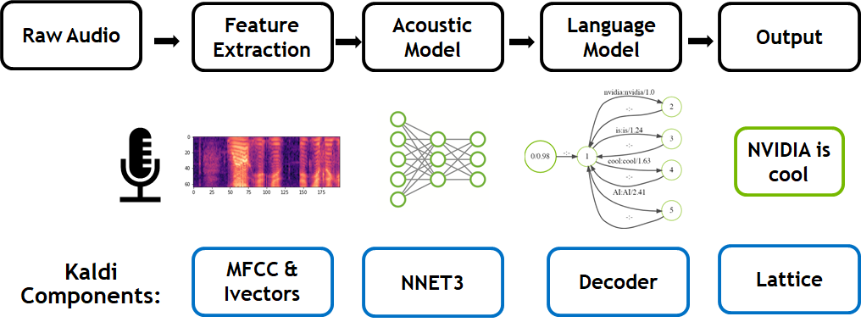
Kaldi Speech to Text
Source: Nvidia Dev Blog

Slide 30
Example Speech to Text: English
Human: Tom came on Monday and went back home the next day.
Google: Tom came on Monday and Wednesday back home the next day
Kaldi: Tom came on monday and went back home the next day

Slide 31
FIFEDOM Results
Kaldi Mandarin Chinese (CVTE Model)
Word Error Rate: 8.25%
Kaldi English (LibriSpeech Model)
Word Error Rate: 5.53% (Clean Audio), 13.99% (‘Other’ Audio Set)
5758 MB Model Size
Remember: Google US-EN Word Error Rate: 4.9%
At ~ 200W on Nvidia 2080 GPU, can process audio at 2500-2900x real time
At ~30W, Nvidia Xavier ($700) can process audio at 500x real time
Xavier idles at ~1.6W, still need to find most efficient operating point
Models are too big for most low cost hardware,
but within size, compute, and power limits

Slide 32
Summary
Data is very important
Big companies really want it
Edge computing is adequately powerful and cheap
But hamstrung by amount of memory on devices
Keeping data at the edge is effective for sensors and data acquisition…
…but less so for services currently done by IoT
Speech recognition for voice commands to devices one exception
Better edge technology probably will not change this situation
Therefore edge computing unlikely to significantly impact privacy

